Slide 1
Multilayer Percetrons
Neural Networks, Simon Haykin, Prentice-Hall, 3rd edition

Slide 2
Multilayer Perceptrons
Architecture
Input
layer
Output
layer
Hidden Layers

Slide 3
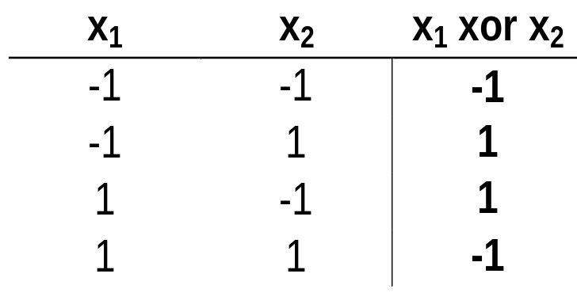
A solution for the XOR problem
x₁
1
-1
1
x₂
-1
-1
0.1
x₁
+1
+1
1 if v > 0
ϕ(v) =
-1 if v ≤ 0
ϕ is the sign function.
-1
-1
x₂
+1
+1
-1
Notes:
NN 3
11-00
Elena Marchiori

Slide 4
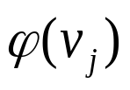
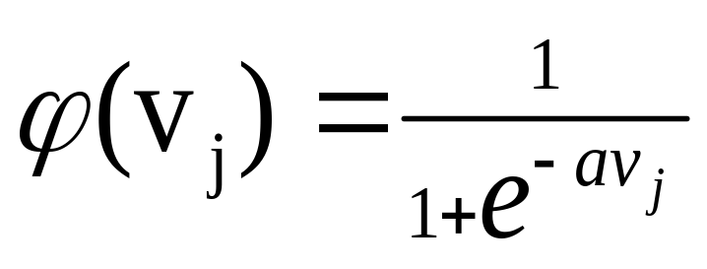

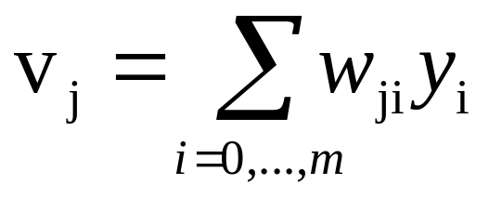

NEURON MODEL
Sigmoidal Function
induced field of neuron j
Most common form of activation function
a →∞ ⇒ ϕ → threshold function
Differentiable
1
Increasing a
-10 -8 -6 -4 -2 2 4 6 8 10

Slide 5
LEARNING ALGORITHM
Back-propagation algorithm
It adjusts the weights of the NN in order to minimize the average squared error.
Function signals
Forward Step
Error signals
Backward Step

Slide 6
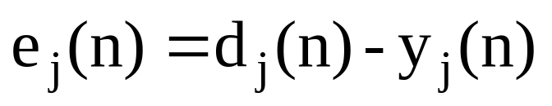
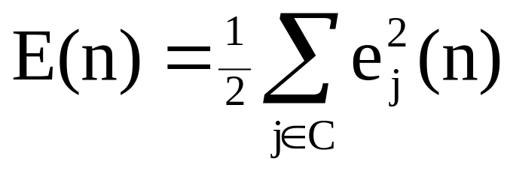
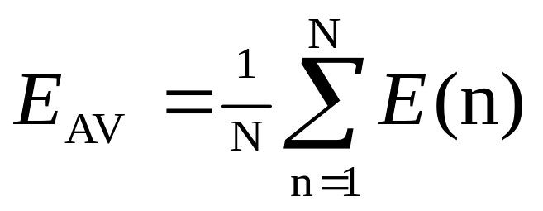
Average Squared Error
Error signal of output neuron j at presentation of n-th training example:
Total energy at time n:
Average squared error:
Measure of learning
performance:
Goal: Adjust weights of NN to minimize E_{AV}
C: Set of neurons
in output layer
N: size of training set
Notes:
NN 3
11-00
Elena Marchiori

Slide 7


Notation
Error at output of neuron j
Output of neuron j
Induced local
field of neuron j

Slide 8
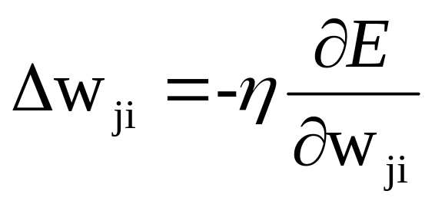

Weight Update Rule
Update rule is based on the gradient descent method
take a step in the direction yielding the maximum
decrease of E
Step in direction opposite to the gradient
With weight associated to the link from neuron i
to neuron j

Slide 9
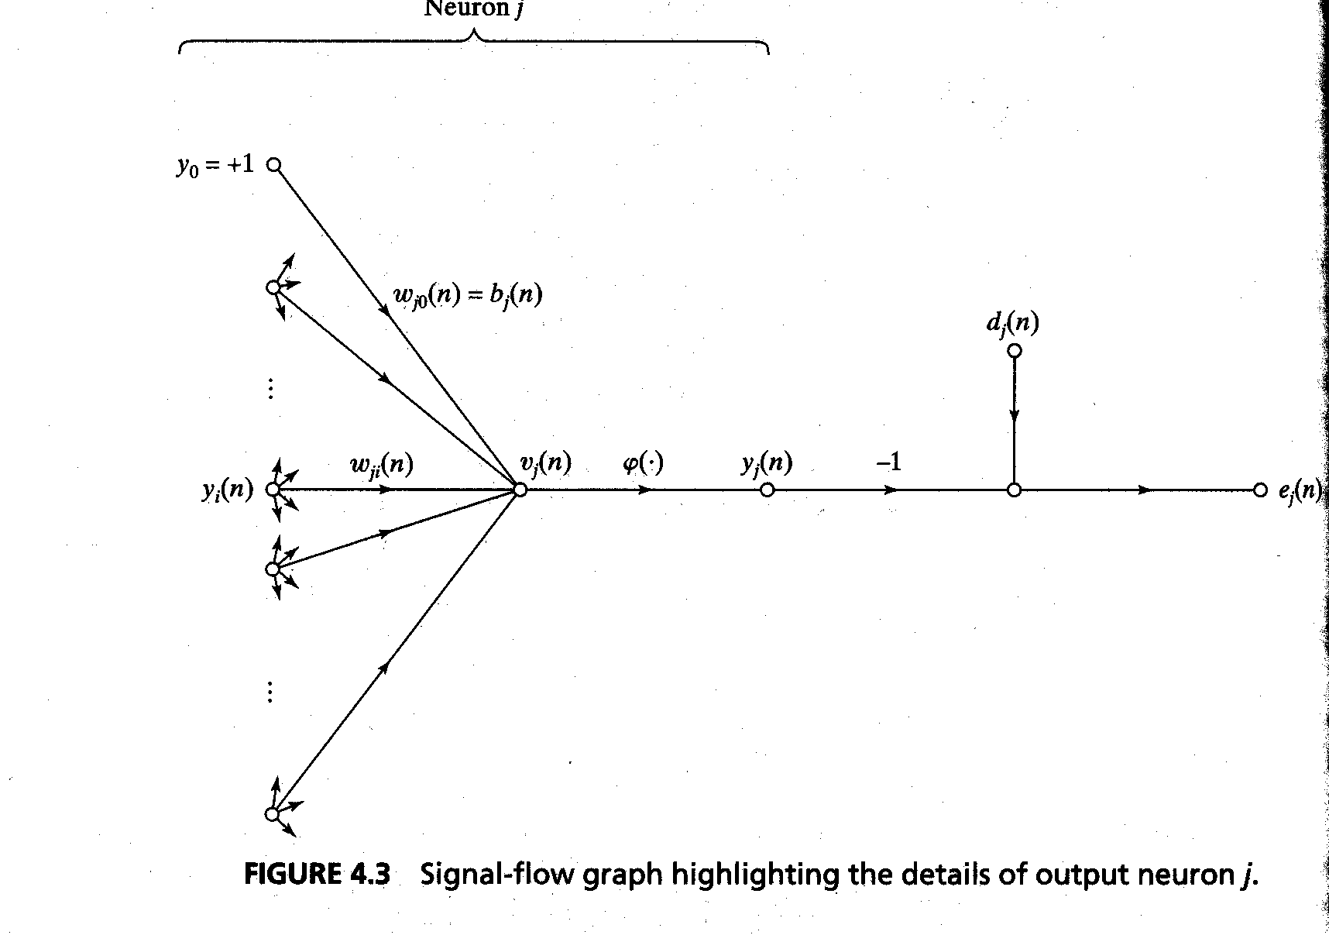

Slide 10
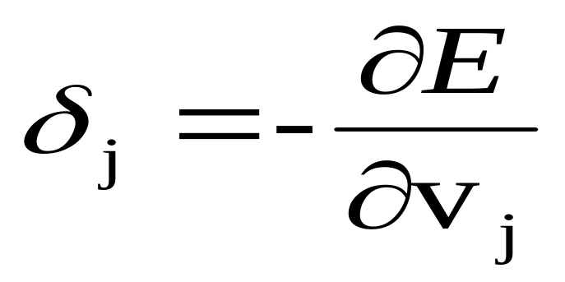
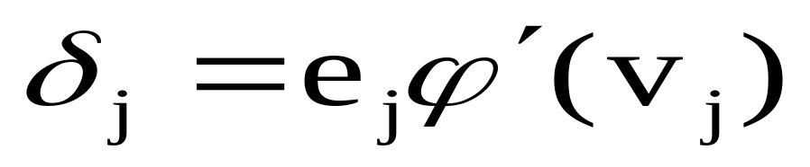
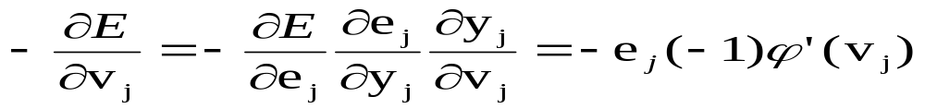
Definition of the Local Gradient of neuron j
Local Gradient
We obtain
because

Slide 11
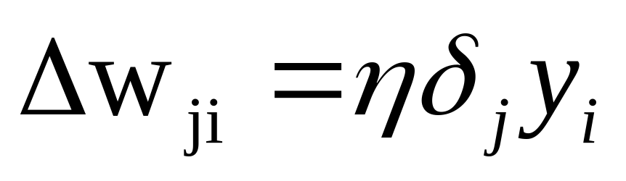
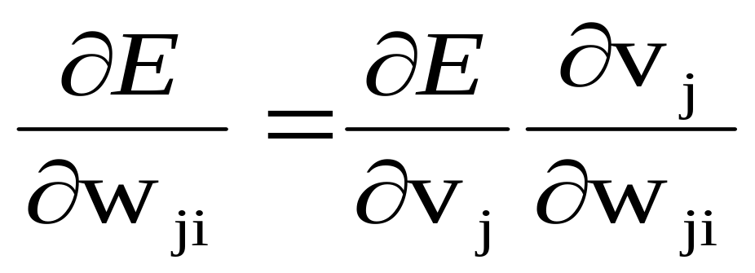
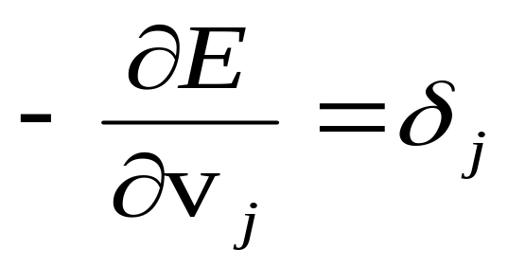
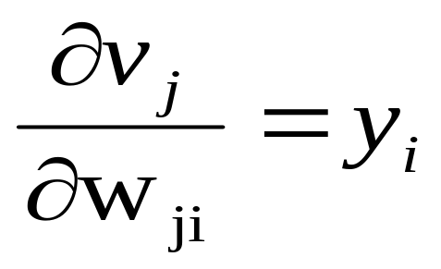
Update Rule
We obtain
because

Slide 12
Compute local gradient of neuron j
The key factor is the calculation of e_{j}
There are two cases:
        Case 1): j is a output neuron
        Case 2): j is a hidden neuron

Slide 13
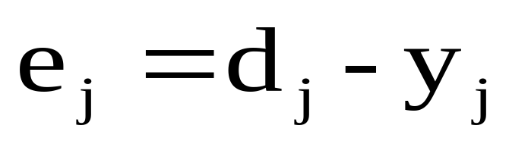
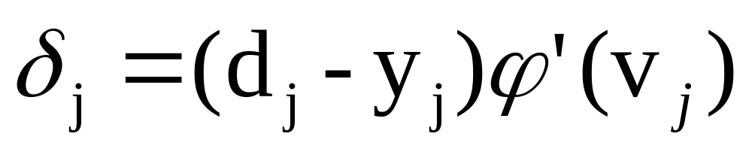
Error e_{j} of output neuron
Case 1: j output neuron
Then

Slide 14
Local gradient of hidden neuron
Case 2: j hidden neuron
the local gradient for neuron j is recursively determined in terms of the local gradients of all neurons to which neuron j is directly connected

Slide 15
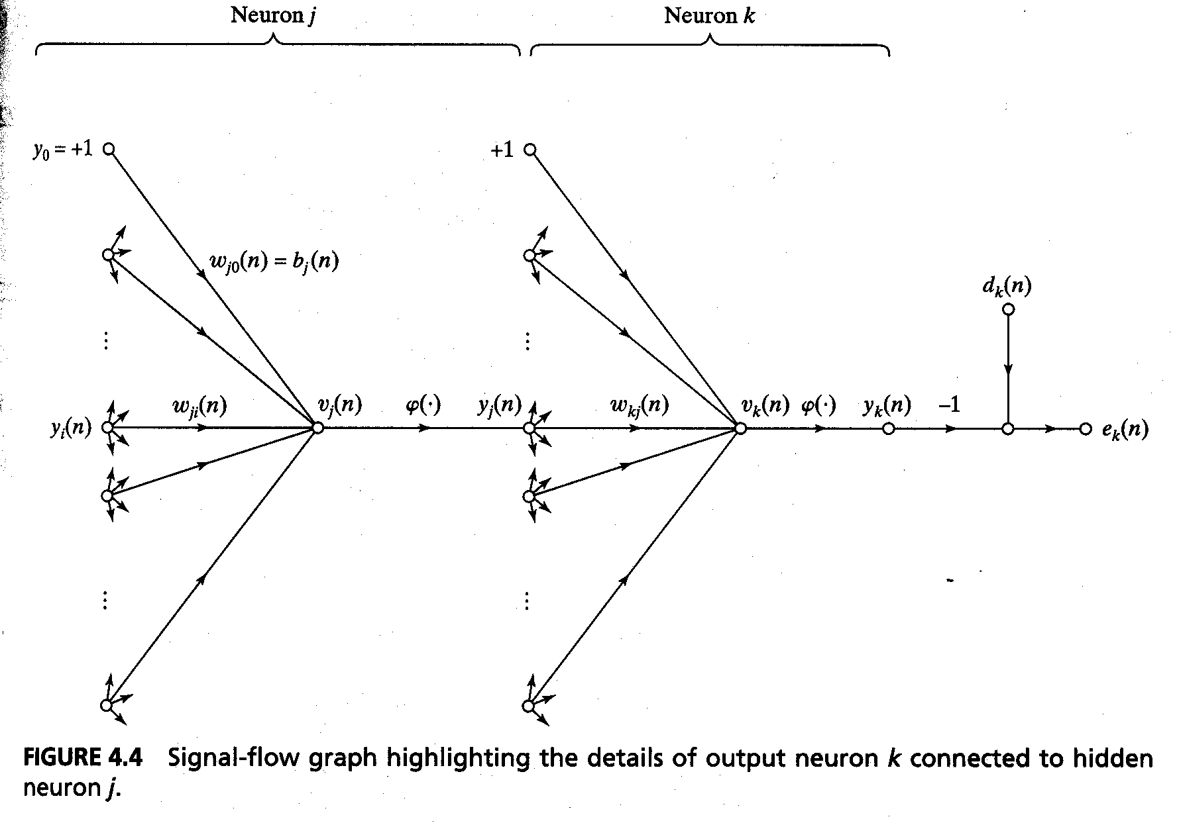

Slide 16
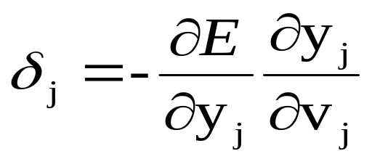
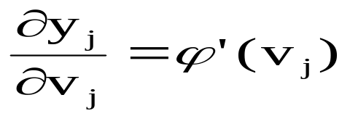
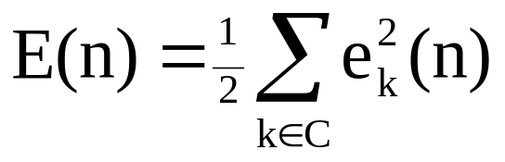
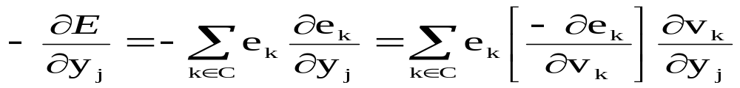
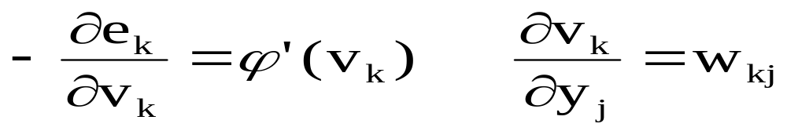
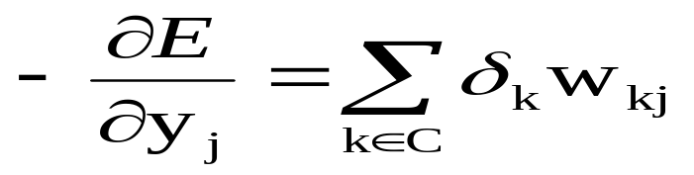
Use the Chain Rule
from
We obtain

Slide 17
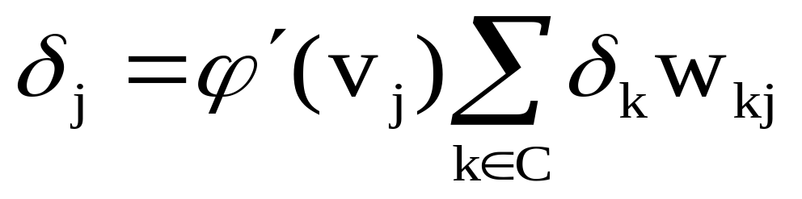
Local Gradient of hidden neuron j
Hence
w_{1j}
e₁
Signal-flow graph of back-propagation error signals to neuron j
δ₁
ϕ’(v₁)
δ_{j}
ϕ’(v_{j})
w_{kj}
e_{k}
ϕ’(v_{k})
δ_{k}
w_{m j}
e_{m}
δ_{m}
ϕ’(v_{m})

Slide 18
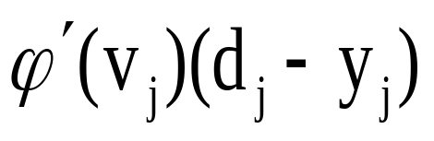
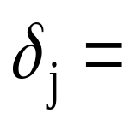
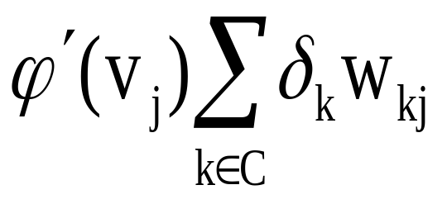
Delta Rule
Delta rule Δw_{ji} = ηδ_{j} y_{i}
C: Set of neurons in the layer following the one containing j
IF j output node
IF j hidden node

Slide 19
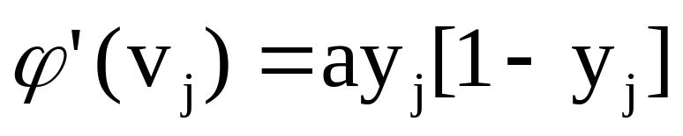
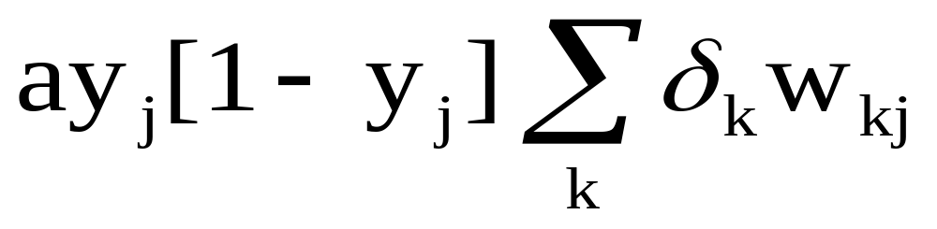

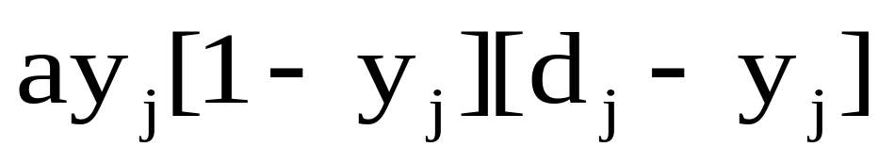
Local Gradient of neurons
a > 0
if j hidden node
If j output node

Slide 20
Backpropagation algorithm
Two phases of computation:
  Forward pass: run the NN and compute the error for each neuron of the output layer.
  Backward pass: start at the output layer, and pass the errors backwards through the network, layer by layer, by recursively computing the local gradient of each neuron.

Slide 21
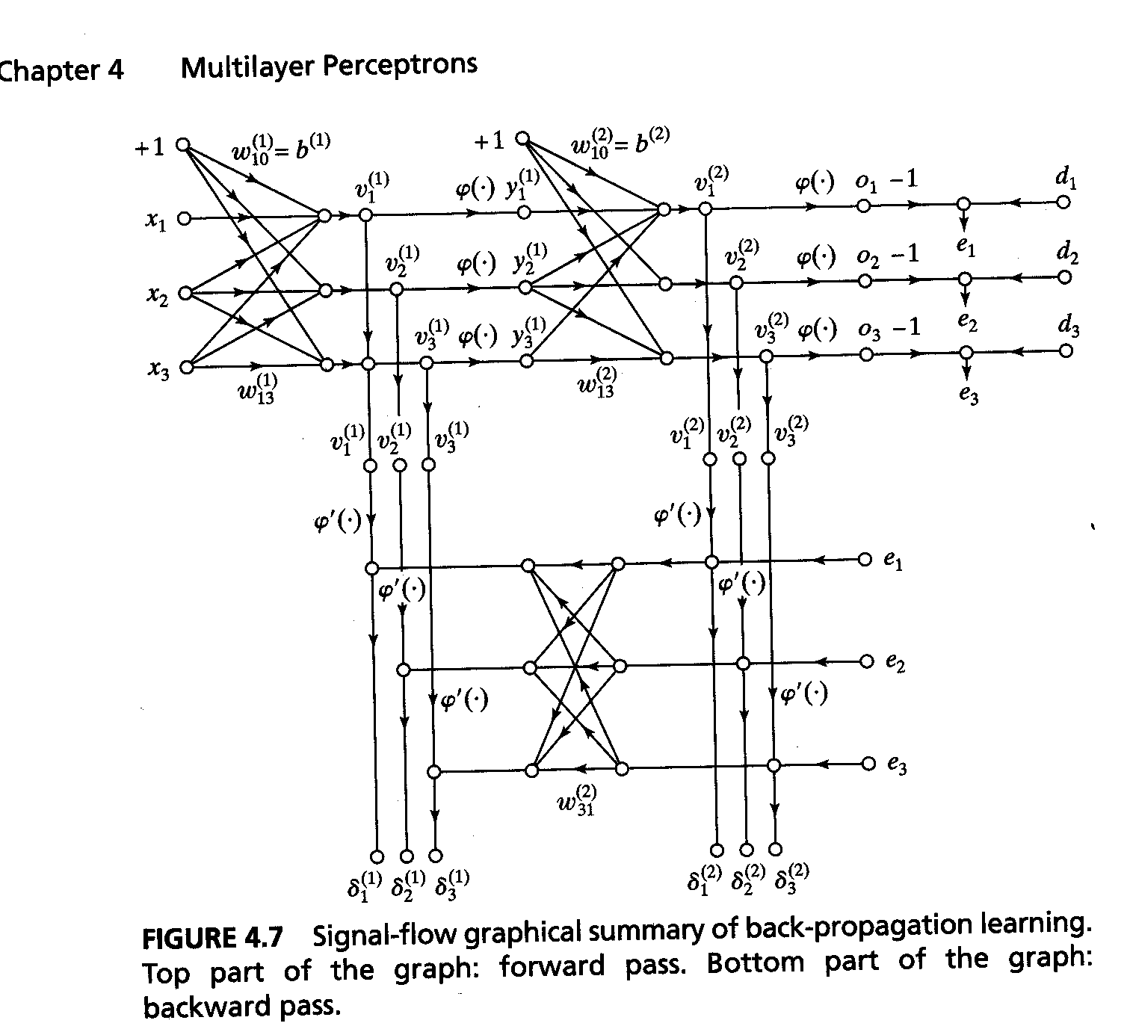
Summary

Slide 22
Training
Sequential mode (on-line, pattern or stochastic mode):
  (x(1), d(1)) is presented, a sequence of forward and backward computations is performed, and the weights are updated using the delta rule.
  Same for (x(2), d(2)), … , (x(N), d(N)).

Slide 23
Training
The learning process continues on an epoch-by-epoch basis until the stopping condition is satisfied.
From one epoch to the next choose a randomized ordering for selecting examples in the training set.
Notes:
NN 3
11-00
Elena Marchiori

Slide 24
Stopping criterions
Sensible stopping criterions:
  Average squared error change: Back-prop is considered to have converged when the absolute rate of change in the average squared error per epoch is sufficiently small (in the range [0.1, 0.01]).
  Generalization based criterion: After each epoch the NN is tested for generalization. If the generalization performance is adequate then stop.

Slide 25
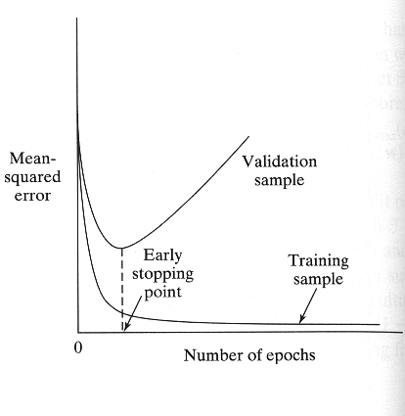
Early stopping

Slide 26
Generalization
Generalization: NN generalizes well if the I/O mapping computed by the network is nearly correct for new data (test set).
Factors that influence generalization:
  the size of the training set.
  the architecture of the NN.
  the complexity of the problem at hand.
Overfitting (overtraining): when the NN learns too many I/O examples it may end up memorizing the training data.
Notes:
NN 3
11-00
Elena Marchiori

Slide 27
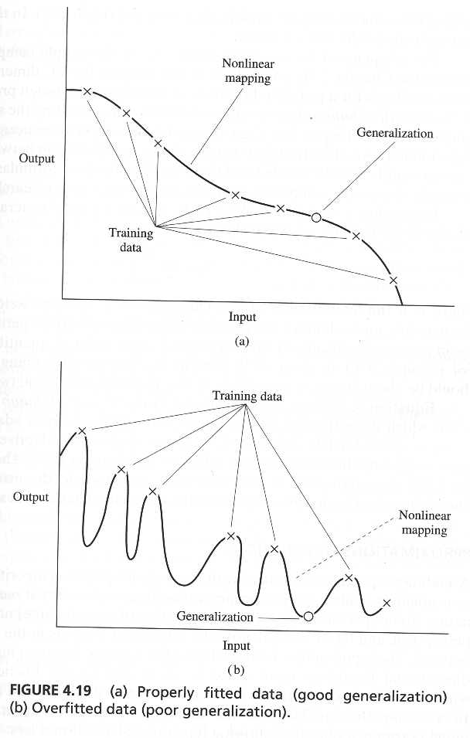
Generalization

Slide 28
Expressive capabilities of NN
Boolean functions:
Every boolean function can be represented by network with single hidden layer
but might require exponential hidden units
Continuous functions:
Every bounded continuous function can be approximated with arbitrarily small error, by network with one hidden layer
Any function can be approximated with arbitrary accuracy by a network with two hidden layers
Notes:
NN 3
11-00
Elena Marchiori

Slide 29
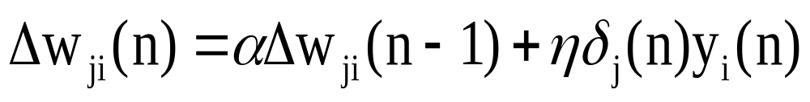
Generalized Delta Rule
If η small ⇒ Slow rate of learning
If η large ⇒ Large changes of weights
⇒ NN can become unstable (oscillatory)
Method to overcome above drawback: include a momentum term in the delta rule
Generalized
delta
function
momentum constant

Slide 30
Generalized delta rule
the momentum accelerates the descent in steady downhill directions.
the momentum has a stabilizing effect in directions that oscillate in time.
PMR5406 Redes Neurais e Lógica Fuzzy

Slide 31
η adaptation
Heuristics for accelerating the convergence of
the back-prop algorithm through η adaptation:
Heuristic 1: Every weight should have its own η.
Heuristic 2: Every η should be allowed to vary from one iteration to the next.
PMR5406 Redes Neurais e Lógica Fuzzy

Slide 32
NN DESIGN
Data representation
Network Topology
Network Parameters
Training
Validation
Notes:
NN 3
11-00
Elena Marchiori

Slide 33
Setting the parameters
How are the weights initialised?
How is the learning rate chosen?
How many hidden layers and how many neurons?
Which activation function ?
How to preprocess the data ?
How many examples in the training data set?

Slide 34
Some heuristics (1)
Sequential x Batch algorithms: the sequential mode (pattern by pattern) is computationally faster than the batch mode (epoch by epoch)
PMR5406 Redes Neurais e Lógica Fuzzy

Slide 35
Some heuristics (2)
Maximization of information content: every training example presented to the backpropagation algorithm must maximize the information content.
  The use of an example that results in the largest training error.
  The use of an example that is radically different from all those previously used.
PMR5406 Redes Neurais e Lógica Fuzzy

Slide 36
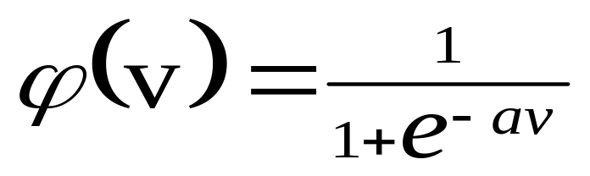
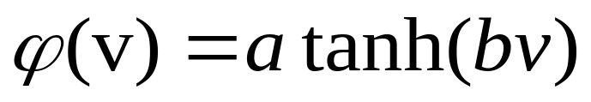
Some heuristics (3)
Activation function: network learns faster with antisymmetric functions when compared to nonsymmetric functions.
Sigmoidal function is
nonsymmetric
Hyperbolic tangent
function is
nonsymmetric

Slide 37
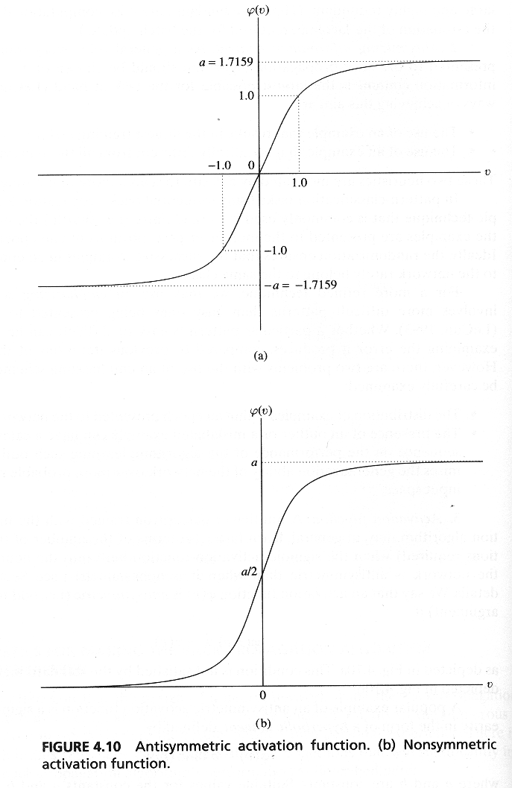
Some heuristics (3)

Slide 38
Some heuristics (4)
Target values: target values must be chosen within the range of the sigmoidal activation function.
Otherwise, hidden neurons can be driven into saturation which slows down learning

Slide 39
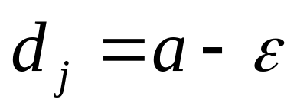
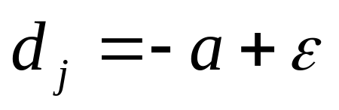
Some heuristics (4)
For the antisymmetric activation function it is necessary to design Є
For a+:
For –a:
If a=1.7159 we can set Є=0.7159 then d=±1

Slide 40
Some heuristics (5)
Inputs normalisation:
  Each input variable should be processed so that the mean value is small or close to zero or at least very small when compared to the standard deviation.
  Input variables should be uncorrelated.
  Decorrelated input variables should be scaled so their covariances are approximately equal.

Slide 41
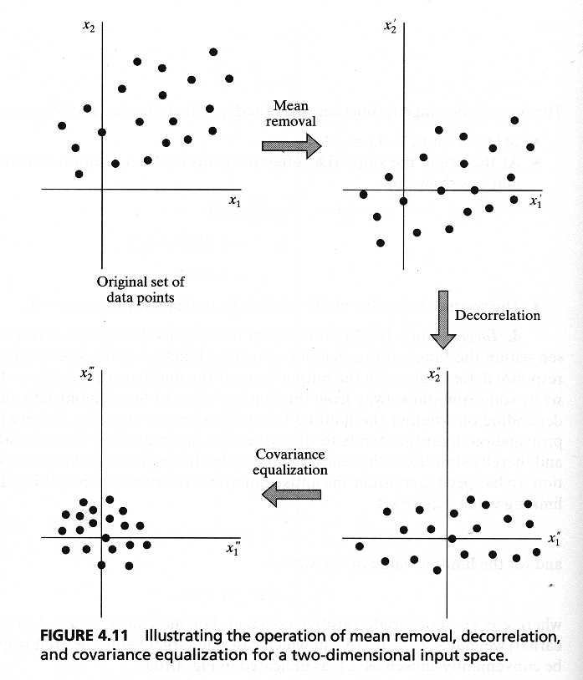
Some heuristics (5)

Slide 42
Some heuristics (6)
Initialisation of weights:
  If synaptic weights are assigned large initial values neurons are driven into saturation. Local gradients become small so learning rate becomes small.
  If synaptic weights are assigned small initial values algorithms operate around the origin. For the hyperbolic activation function the origin is a saddle point.

Slide 43
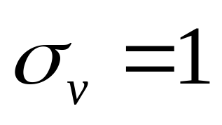
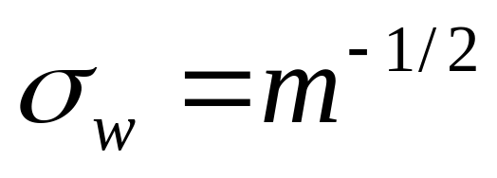
Some heuristics (6)
Weights must be initialised for the standard deviation of the local induced field v lies in the transition between the linear and saturated parts.
m=number of weights

Slide 44
Some heuristics (7)
Learning rate:
  The right value of η depends on the application. Values between 0.1 and 0.9 have been used in many applications.
  Other heuristics adapt η during the training as described in previous slides.

Slide 45
Some heuristics (8)
How many layers and neurons
  The number of layers and of neurons depend on the specific task. In practice this issue is solved by trial and error.
  Two types of adaptive algorithms can be used:
    start from a large network and successively remove some neurons and links until network performance degrades.
    begin with a small network and introduce new neurons until performance is satisfactory.

Slide 46
Some heuristics (9)
How many training data ?
  Rule of thumb: the number of training examples should be at least five to ten times the number of weights of the network.

Slide 47
Output representation and decision rule
M-class classification problem
Y_{k,j}(x_{j})=F_{k}(x_{j}), k=1,...,M
Y_{1,j}
MLP
Y_{2,j}
Y_{M,j}

Slide 48
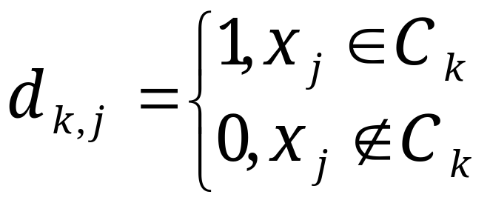
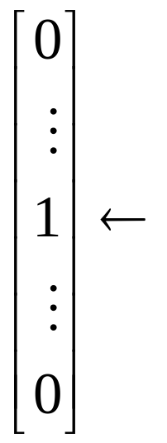
Data representation
Kth element

Slide 49
MLP and the a posteriori class probability
A multilayer perceptron classifier (using the logistic function) aproximate the a posteriori class probabilities, provided that the size of the training set is large enough.

Slide 50
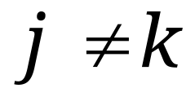
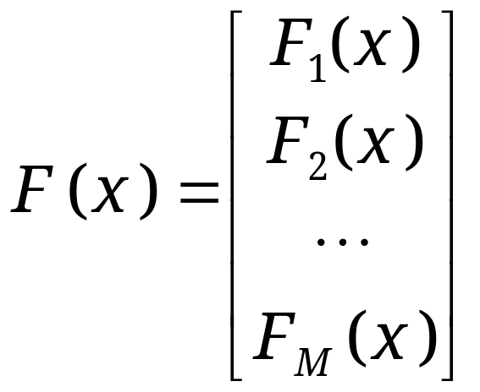
The Bayes rule
An appropriate output decision rule is the (approximate) Bayes rule generated by the a posteriori probability estimates:
xЄC_{k} if F_{k}(x)>F_{j}(x) for all

